Slide 1
NFC Tags
Divyesh, Sai, Andrew, Akshay & Maanas
Group 11
Notes:
Consider adding wireframes to the next presentation

Slide 2
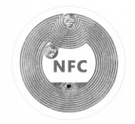
About NFC (Near Field Communication) Tags
Facilitates data transfer between two devices i.e. phones, tablets, smart watches.
Contactless interaction, made very popular during the pandemic.
20% of the population has access to NFC technology
Nokia launched first NFC enabled phone in 2006, but did not take off till recently
Work wirelessly without needing WiFi or LTE.
The payments are very secure, with tokenization and encryption
Devices need to be in a 10-20 cm radius to communicate.
Other alternatives with longer ranges, but not as efficient i.e. RFID.
Notes:
//sai

Slide 3
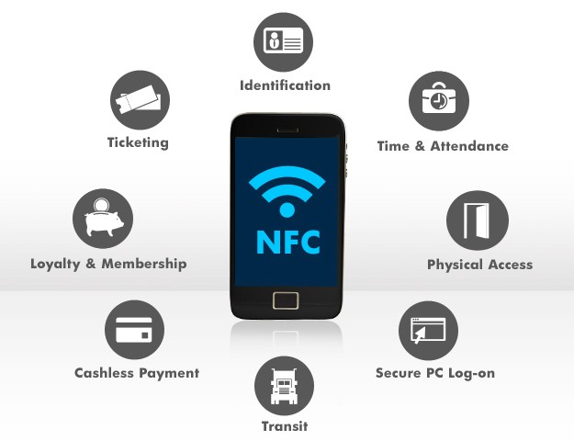
Uses of NFC (Examples)
Contactless Payments
Apple Pay
Google Wallet
Home Security
Lock/Unlock
Cars
Lock/Unlock
Start/Stop engine
Transportation
Metro
Digital Tickets

Slide 4
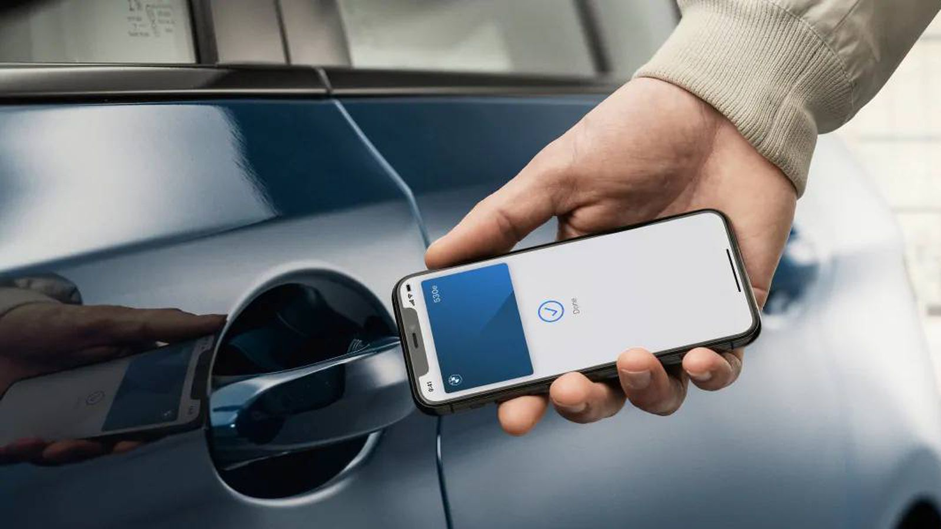
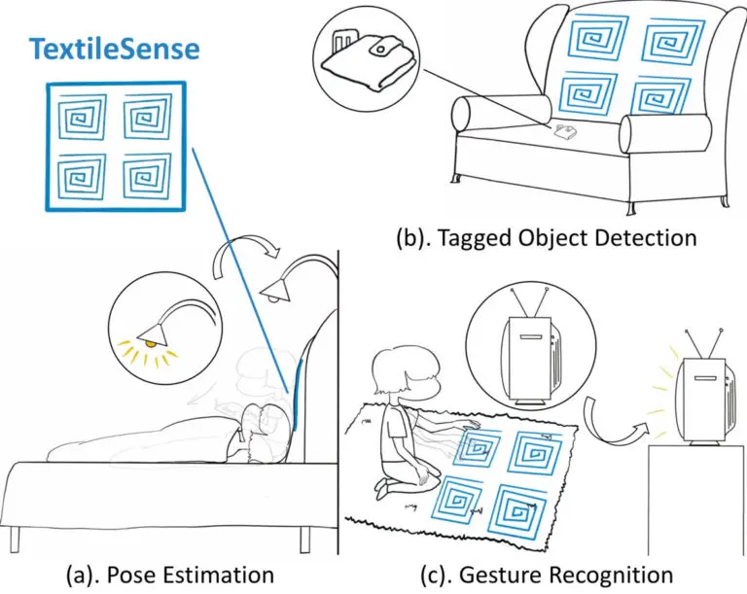
Latest Trends in NFC
Sprayable NFC tags: Smart Furniture
Check product legitimacy
Prevent Identity Frauds
Wireless earbuds charging and power share
Unlock cars and homes without keys
Notes:
Maanas- Coming to the latest trends in NFC technology, Researchers at Carnegie mellon University have developed fabric-friendly sprayable NFC sensors that can be woven or sprayed on furniture. THey enable users to interact with their smart home devices and even make adjustments to suit their comfort level.
Brands like Nike also integrated NFC tags in their sneakers to check their product legitimacy, NFC tags are also being used to prevent identity thefts online, wirelessly charge our mobile phones through power sharing or our earbuds, and even unlock cars and house doors without the use of keys

Slide 5
NFC vs RFID
NFC
User Centric, subset of RFID
Mobile Payments
Secure payments and single use transaction no. is generated each time
Invisible and integrated easily
RFID-Radio Frequency Identification devices
Item/Product Centric used by product manufacturers/retailers
Tracking/Tracing items, alerts, e-wallets
Can be hacked and reprogrammed
Usually large and visible
Notes:
Maanas- NFCs are very much similar to RFID or Radio Frequency Identification devices, however, there are a few key differences between them. NFCs are a subset of RFIDs and are more user friendly/user centric, on the other hand, RFIDs are product centric, this is why product manufacturers and retailers use RFIDs to track and trace their items, and even alert stolen items. NFCs can be used by public for secure mobile payments like Apple pay & Google pay where a single use transaction number is generated each time. NFCs can be integrated easily within the device and are often not visible, but RFIDs are usually large or visible

Slide 6
How it works
NFC Tag → NFC Reader
Devices communicate via radio waves to activate the receiving device
Typical Procedure:
User holds NFC tag in close proximity to NFC reader
Will only work in short distances ~ 5 inches
Radio wave is sent to the the readers antenna to activate the device
Encrypted data exchange occurs between the two devices
An NFC tag will only connect to one NFC reader at a time
Tag and reader deactivate after exchange
NFC tags do not have batteries but instead draw power from the host (Ex. Smartphones)

Slide 7
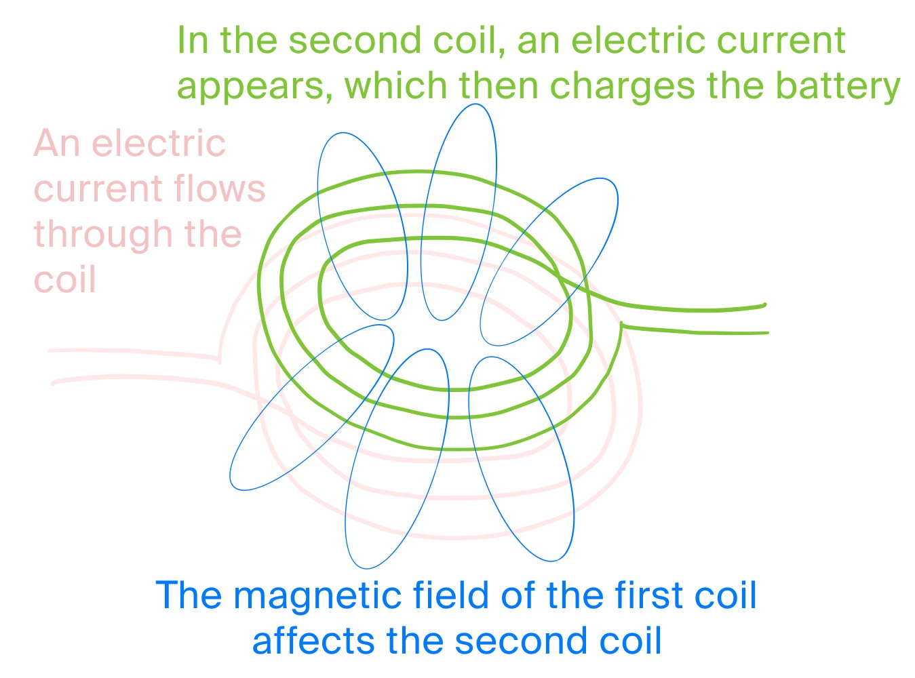
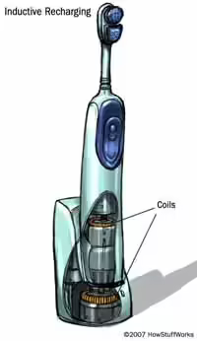
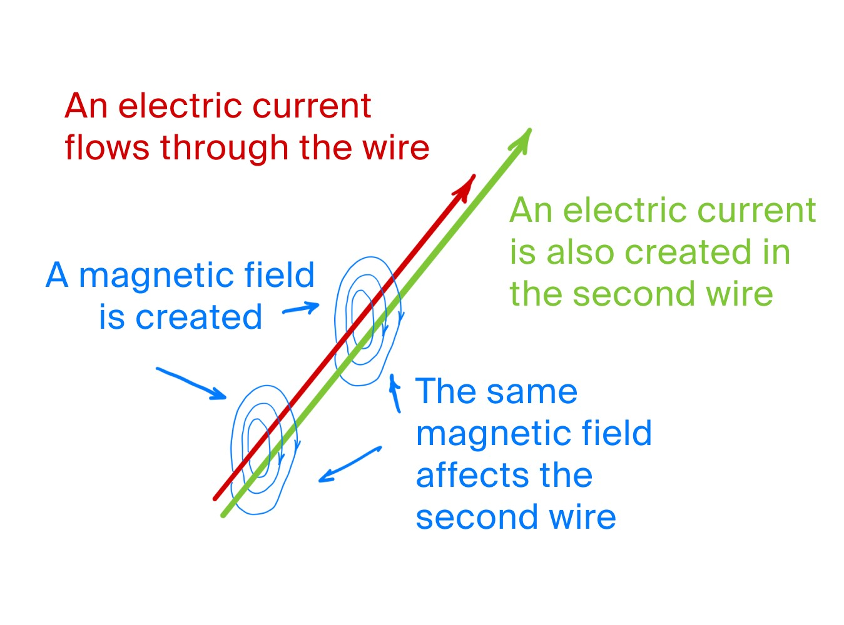
How are NFC Tags Powered?
Powered by reading device
Magnetic induction

Slide 8
NFC Tag Security Risks
Eavesdropping
Close range
During transaction
Data corruption and manipulation
Corrupt data being sent to reader
Middleman interception
Similar to data corruption
Physical theft
E.g. Stolen ID card

Slide 9
Disadvantages of NFC
Only works for short distances
The power utilization is more in NFC empowered gadgets
Low information move rates from 106-424 kbps
Only good for quick transactions
More secure than credit cards but not totally risk free
Due to prominence of mobile based hacking these days
Interception Attacks
NFC data transfer is rerouted to a device other than the one that is intended
Notes:
//sai

Slide 10
Advantages of NFC
Low cost at Scale
Battery free function
Cannot be Cloned
Can be updated
Compatible with existing devices and RFID
Light and Thin form factor

Slide 11
Discussion
What other uses and drawbacks can emerge from NFC tags if we extend their range?

Slide 12
References
https://electronics.howstuffworks.com/everyday-tech/wireless-power.htm
https://www.nomtek.com/blog/what-are-nfc-tags
https://electronics.howstuffworks.com/everyday-tech/wireless-power.htm
https://medium.com/practicum-by-yandex/how-wireless-charging-works-1b8f3e40be5c#:~:text=When%20you%20put%20such%20a,will%20charge%20the%20phone's%20battery
https://blog.beaconstac.com/2020/10/nfc-latest-trends/
https://www.nfcw.com/nfc-world/researchers-unveil-fabric-friendly-nfc-sensors-that-track-tags-everyday-objects-and-people/
http://nearfieldcommunication.org/nfc-security.html
https://gotap.uk/nfc-knowledge/security-privacy-and-safety-with-nfc/#:~:text=Data%20Corruption%20and%20Manipulation,being%20sent%20to%20another%20device.

